Slide 1
python
Language syntax and programming constructs
Gene Olafsen

Slide 2
JupYter Notebook
This slide deck is accompanied by a Jupyter notebook file containing examples of language concepts.
Download and install Anaconda for Python 3 and Jupyter notebook support.
https://www.anaconda.com/download/
The accompanying notebook can be found at:
https://github.com/geneostrat/Metrowest-Developers-Machine-Learning-Group

Slide 3
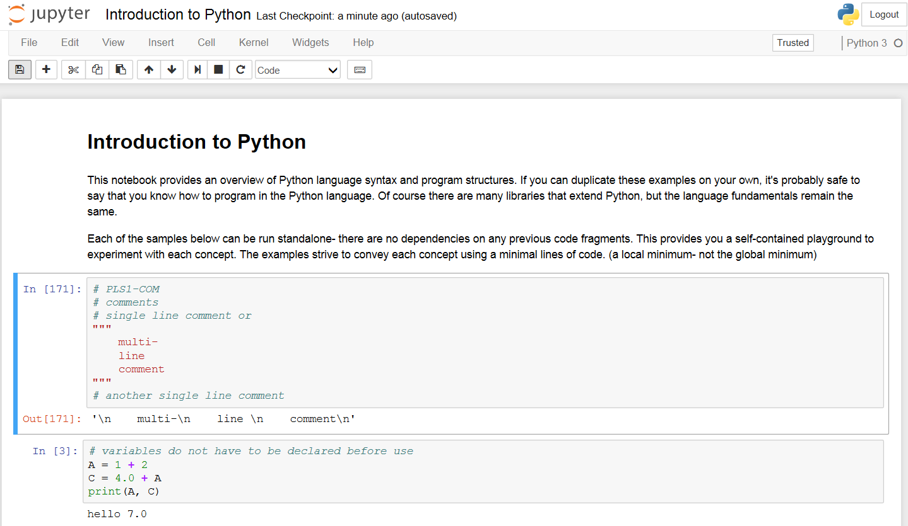
Notebook

Slide 4
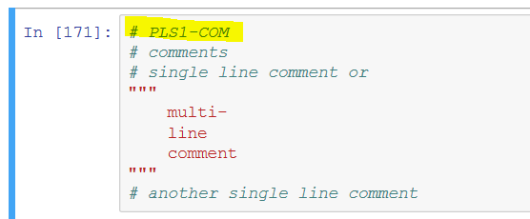
Notebook cell identifier pls1-com
An example identifier comment is placed at the top of each referenced cell. (highlighted below)
Slide titles will also have the cell identifier (see above)

Slide 5
Comments pls1-com
Single and multi-line comments are supported

Slide 6
Variables PLS1-VAR1-3
Variable type is established at initialization.
A variable may be assigned to a different type at any time.
Multiple variables may be initialized at once.

Slide 7
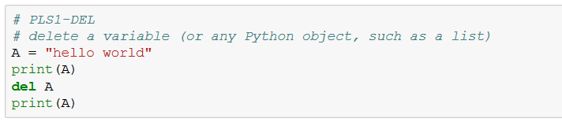
Delete PLS1-DEL
The DEL command is used to delete variables or any other object. Even though Python has had a garbage collector since version 2, this command provides a mechanism to manage memory directly.

Slide 8
PRINT pls1-print1,2
The PRINT command outputs to the Python console.
Multiple values may be printed on the same line separated by a comma.
The newline character \n forces subsequent print statements to the next line.
A print statement with an end="" argument allows the next print statement to appear on the same line.

Slide 9
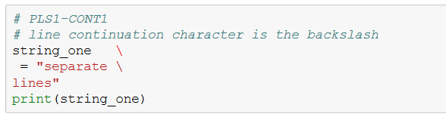
Spanning lines PLS1-Cont1,2
Use the backslash character '\' to span both Python expression and PRINT statements.

Slide 10
Indentation pls1-ind
Python requires all statements within a block to be indented the same amount.
Python indentation rules equate to the use of curly brackets in C/C++/C#/Java, etc.
It can be argued that indentation is less ambiguous than using curly brackets.

Slide 11
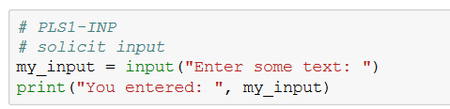
Input PLS1-inp
The INPUT command is used to solicit text from the console.
The command accepts a prompt string argument.

Slide 12
Immutable types PLS1-imt
Boolean, integer, long, float, tuple, string, complex-number and frozenset.
A type is immutable if it's value is fixed upon initialization.
Changing the assignment of a variable causes Python to re-evaluate the type associated with that variable.

Slide 13
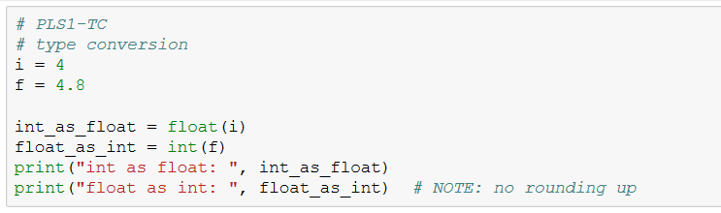
Type conversion pls1-tc
Python supports type conversion.

Slide 14
Tuples and lists pls1-TL1,2
Tuples and Lists are collection objects.
Tuples are immutable and defined with the collection contained in parenthesis.
Lists are dynamically defined and initialized with a collection contained in square-brackets.
Tuples and Lists collections may contain a mix of types.
Lists support more operations (insert, delete, etc.) however they are slower than tuples.

Slide 15
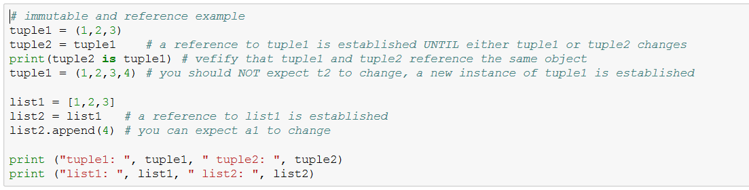
References PLS1-REF

Slide 16
Slicing pls1-SLC1,2
Square brackets and a colon are used to contain and separate the range for both Tuples and Lists.
[start-index:length]
New objects are returned by slice operations.

Slide 17
Common Tuple and List operators PLS1-Op1,2
Operators include:
+ add two collections together
* multiple the collections
Some operations occur in-place
Sort, Reverse, Random

Slide 18
Dictionary Pls1-dct
Dictionary is a collection of key-value pairs.
Dictionary keys and values can be of any type.
KEY:VALUE pairs are contained in {} and separated by a :
my_dictionary = {1:'one', 2:'two', 3:'three'}
Items may be added, removed or changed.

Slide 19
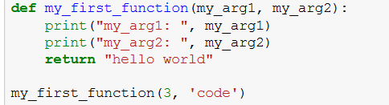
Functions PLS1-FN1,2
Python functions are objects.
Functions may return multiple values/objects.

Slide 20
Function arguments PLS1-ARG1,2,3
Function arguments that are value types will not be changed for the caller if changed within a function.
Function arguments that are passed by reference (lists, etc.) may be changed within the function and changed for the caller as well.
Python supports default argument values.

Slide 21
First class
Python supports classes
Abstraction
Encapsulation
Inheritance
Spacecraft
craft_configuration

Slide 22
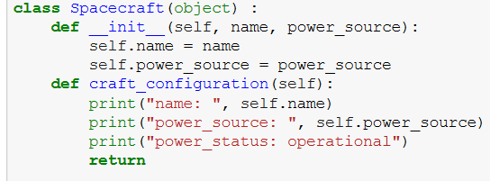
Class pls1-cl1
__init__ is the constructor name for all Python classes.
A colon ':' identifies the beginning of an indentation block.

Slide 23
class introspection pls1-cl2
__dict__
Used to access the class attribute dictionary
hasattr
getattr
setattr

Slide 24
Subclass PLS1-CL3
Spacecraft
(base class)
Class inheritance
craft_configuration
Voyager
(derived class)
transmit

Slide 25
Method override PLS1-CL4
Spacecraft
(base class)
Class inheritance
craft_configuration
Voyager
(derived class)
transmit
craft_configuration

Slide 26
hidden class attribute pls1-cl5
An attribute prefixed by double-underscores '__' can not be accessed outside the scope of the class.
It is not returned by __dict__

Slide 27
Parameters pls1-pr1,2
Any class method or standalone function supports the following:
Named parameters
Default parameters
Variable number of parameters

Slide 28
Assert pls1-at
Asserts are commonly placed at the beginning of functions to enforce the presence of parameters before getting into the function specific logic.
Asserts are also common when writing unit tests.

Slide 29
Exceptions PLS1-EXC1-3
Python supports:
Exception handling with TRY-CATCH-FINALLY
Raising exceptions with RAISE

Slide 30
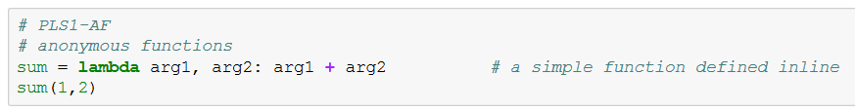
Anonymous functions pls1-af
Inline functions

Slide 31
Iterators pls1-it1,2
An iterator is an object representing a stream of data.
Iterators typically only provide the next item.
Python allows for the creation of custom iterators.

